Slide 1

HELLO!
We are Group 4
We are here because we love to give presentations.

Slide 2




TEAM PRESENTATION
Nguyễn Đan Trường
Blue is the colour of the clear sky and the deep sea
Nguyễn Anh Đức Blue is the colour of the clear sky and the deep sea
Khúc Nguyễn Huy Cường Blue is the colour of the clear sky and the deep sea
Bùi Hữu Luận
Blue is the colour of the clear sky and the deep sea

Slide 3
SOME OTHER ISSUES ABOUT THE E-COMMERCE PLATFORM

Slide 4
I.SECURITY AND DATA PROTECTION
Let’s start!

Slide 5
1.BASIC SECURITY AND CONFIDENTIALITY ISSUES RAISED IN E-COMMERCE
FROM A USER PERSPECTIVE:
-HOW TO KNOW IF THE WEB SERVER IS OWNED BY A LEGITIMATE BUSINESS?
-HOW TO KNOW THIS WEBSITE DOES NOT CONTAIN DANGEROUS CONTENT OR CODE?
- HOW DO YOU KNOW THAT THE WEB SERVER DOES NOT PROVIDE YOUR INFORMATION TO A THIRD PARTY?
FROM A BUSINESS PERSPECTIVE:
- HOW TO KNOW THAT THE USER DOES NOT INTEND TO DESTROY OR CHANGE THE CONTENT OF THE WEBSITE OR WEBSITE?
-HOW TO KNOW IF THE SERVER IS INTERRUPTED?
FROM BOTH SIDES:
-HOW TO KNOW NOT TO BE EAVESDROPPED ONLINE?
-HOW TO KNOW THAT THE INFORMATION FROM THE SERVER TO THE USER HAS NOT BEEN CHANGED?

Slide 6

2. ASPECTS OF E-COMMERCE SECURITY

Slide 7
a. Privacy
-Privacy includes preventing any activity that will lead to the sharing of customers’ data with unauthorized third parties. Apart from the online seller that a customer has chosen, no one else should access their personal information and account details.

Slide 8
b. Integrity
Integrity is another crucial concept of eCommerce Security. It can be simply understood as:
-INFORMATION CANNOT BE CHANGED DURING TRANSMISSION AND RECEPTION
-INFORMATION CANNOT BE ALTERED IN ANY WAY BY UNAUTHORIZED PERSONS

Slide 9
c. Authentication
-The principle of authentication in eCommerce security requires that both the seller and the buyer should be real. They should be who they say they are.
+The business should prove that it is real, deals with genuine items or services, and delivers what it promises.
+The clients should also give their proof of identity to make the seller feel secure about the online transactions. It is possible to ensure authentication and identification. If you are unable to do so, hiring an expert will help a lot.

Slide 10
d. Non-repudiation
-Repudiation means denial.
-Non-repudiation is a legal principle that instructs players not to deny their actions in a transaction.

Slide 11
3.SECURITY COMMON ISSUES IN E-COMMERCE

Slide 12
SECURITY ISSUES IN E-COMMERCE
1.Payment fraud
4. Bots
7. SQL injections
2. Spam
5. DDoS
8. XSS cross-page attack
3. Phishing
6. Brute-force Attack
9. Trojan Horse

Slide 13
4.E-COMMERCE SECURITY SOLUTIONS

Slide 14

4.1. Use HTTPS
HTTPS is a mandatory standard for all websites, especially e-commerce. The HTTPS protocol helps secure the message transmitted between the server and the client. This not only helps to secure the user's account, but also helps the eCommerce website avoid many risks of attack.
This Photo by Unknown Author is licensed under CC BY-SA

Slide 15

4.2.Server security and admin panel
-If you own your own server, end-point security is necessary for all e-commerce websites. In addition, website administrators need to have the knowledge to protect their admin accounts by:
•Set difficult passwords, change passwords periodically
•Beware of unreliable software, links, emails.
• Clear account decentralization.
•Set an alert when a strange IP address is logged into the Admin panel.
-Example of setting a password:
•Less secure password : duckcope123
•More secure passwords: duckCope@123$$
This Photo by Unknown Author is licensed under CC BY-NC

Slide 16


4.3. Payment system security
To secure the payment gateway, businesses need to comply with the followingminimum standards:
•Ssl certificate integration encrypts transmission information
•PCI DSS Security Standard
•OTP Password
•128-bit MD5 encryption
•User token saving mechanism
•Do not keep the user's card information.

Slide 17

4.4. Use antivirus and malware (End-point security)
End-point security solutions are essential for e-commerce businesses. No business owner wants their company to be infected with viruses, ransomware, spyware or trojans. Therefore, every working computer needs to be equipped with an effective malware-killing software. Some effective, simple software such as Bitdefender, Windows Defender, Malwarebytes will be potential candidates.

Slide 18

4.5. Use a Firewall – Web Application Firewall
One of the most effective ways to secure an e-commerce website is to use a web firewall. It will help distribute traffic and eliminate malicious traffic accessing the site. This limits the risk of ddos attacks. Firewalls have also proved effective against SQL injection and XSS. One of the most popular firewalls is Cloudflare Firewall, Amazon's AWS WAF.

Slide 19
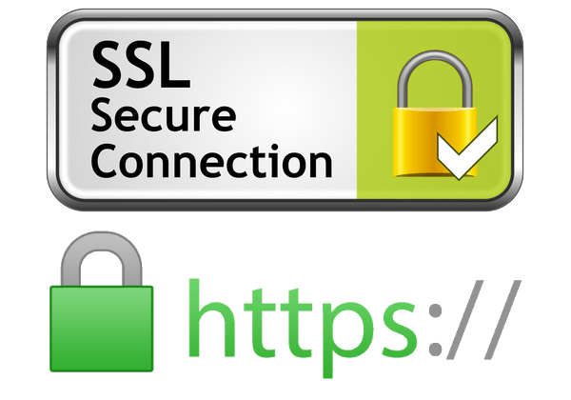
4.6.Advanced SSL Certificate (EV SSL)
Large e-commerce websites should use EV SSL instead of a regular SSL certificate. Although the security features of these two types of SSL certificates are the same. But owning AN SSL EV will help e-commerce websites avoid phishing, thereby better protecting consumers.

Slide 20

4.7. Multi-storey security
Some argue that just a firewall is enough to combat cybersecurity risks for e-commerce. This is a misconception. In fact, hackers are incredibly sophisticated and intelligent. Leaders, CTO, CISO need to implement security with many different layers, from endpoint solutions to solutions to evaluate network systems from within, penetration testing, or organizing bug bounty programs to mobilize community resources – improving security to the maximum.

Slide 21

4.8. Backup data
Data backup is a simple but effective solution against attacks or security risks for e-commerce.
Every time the website has a problem that cannot be solved by conventional response measures, you can restore the backup to continue serving users.
The difficulty with backing up data is choosing the right solution for the enterprise size and easily scaled up when needed.
Amazon Web Service's backup service will solve this problem for the majority of businesses. In addition, offline backup should also be taken as a backup when the worst case scenario occurs.

Slide 22

4.9. Raise security awareness for employees
"The most dangerous technological vulnerability lies in the human factor."
Shark Pham Thanh Hung on Shark Tank Vietnam correctly pointed out the biggest security risk in technology in general and security in particular, which is people. Even if e-commerce is equipped with a solid defense system, a single employee's flaw in the operation can cause hackers to break into the organization and sabotage. That's why organizing short-term training classes on security and internet usage knowledge is important in enhancing the organization's cybersecurity.

Slide 23

4.10. Warning users and partners
Sometimes, the risk does not come directly but indirectly from the customers and partners of the e-commerce business. An online travel agency (OTA) like VNtrip has hundreds of thousands of users and thousands of hotel partners. These are the channels that attackers can take advantage of to target your own business.
Therefore, it is necessary to ensure that customers and partners are provided with basic security knowledge to avoid common risks. For example, ask users to set passwords including lowercase - capital letters, a mixture of letters and numbers. Alert users and clients to the latest trends in phishing attacks through push notifications.

Slide 24
II.Payment System

Slide 25
What is an eCommerce payment?

Slide 26
1. How to set up e-Commerce payment and how does e-commerce payment work?
Requirements of an electronic payment system: To use an electronic payment system, you must have an account (Merchant Account) and a payment gateway.
- Merchant account
- Payment gateway

Slide 27
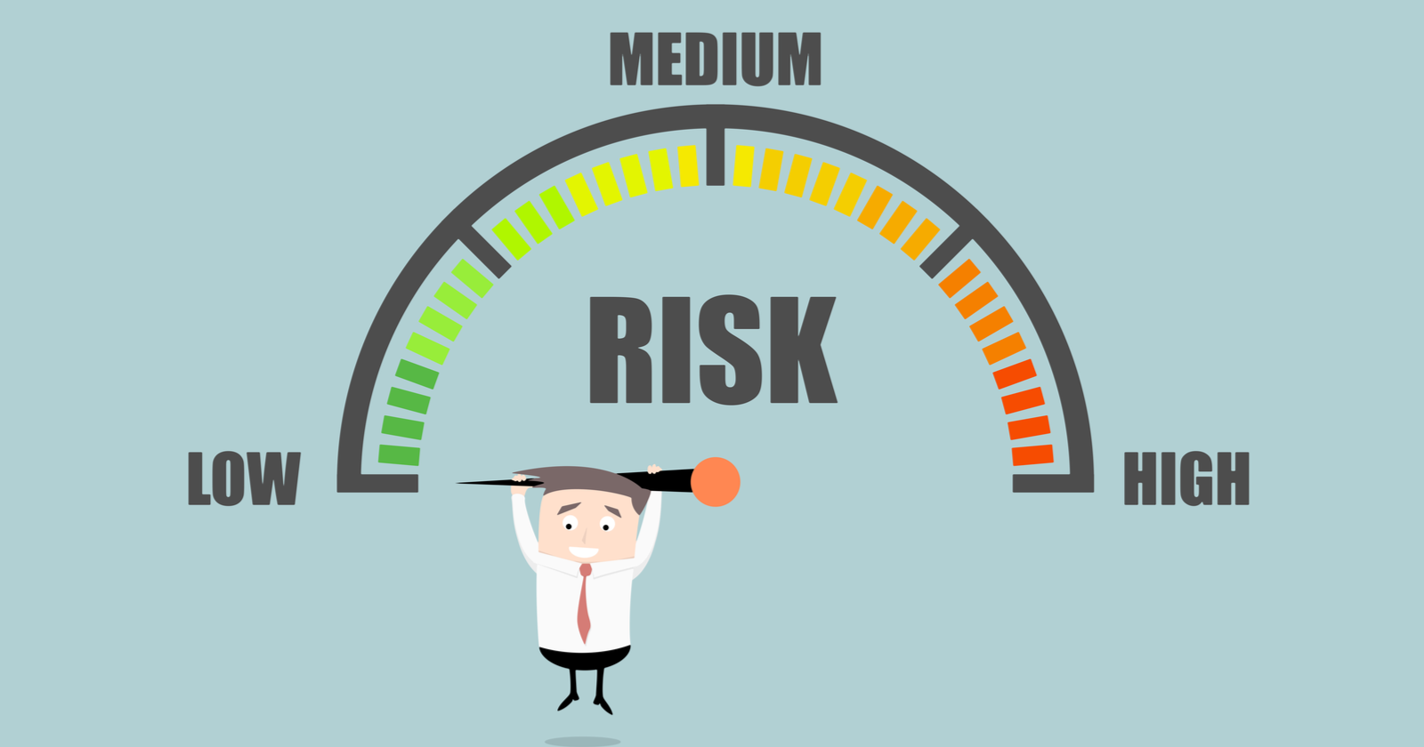

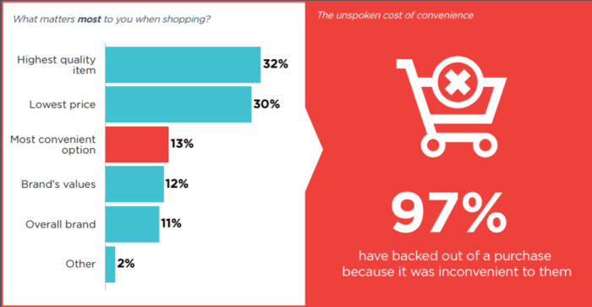

2.Preeminent benefits that eCommerce payment brings
Fast, convenient, suitable for the market flow
Easy to monitor and control
-Limit risks when using cash
-Professionalize your online business

Slide 28

3.Disadvantages of Electronic payment
-Online Security
-Missed Errors
-Fees

Slide 29

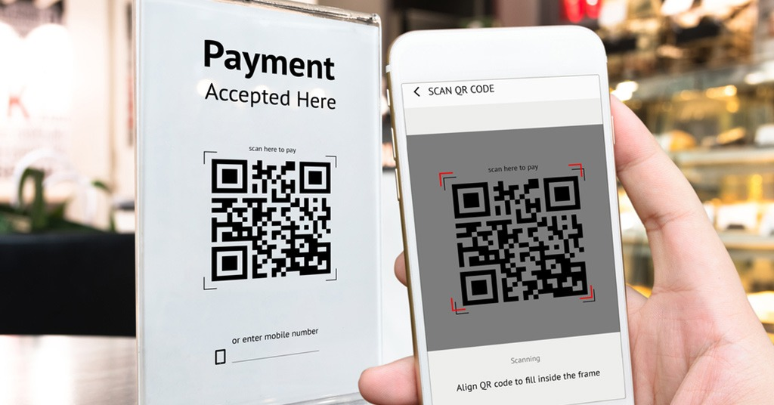

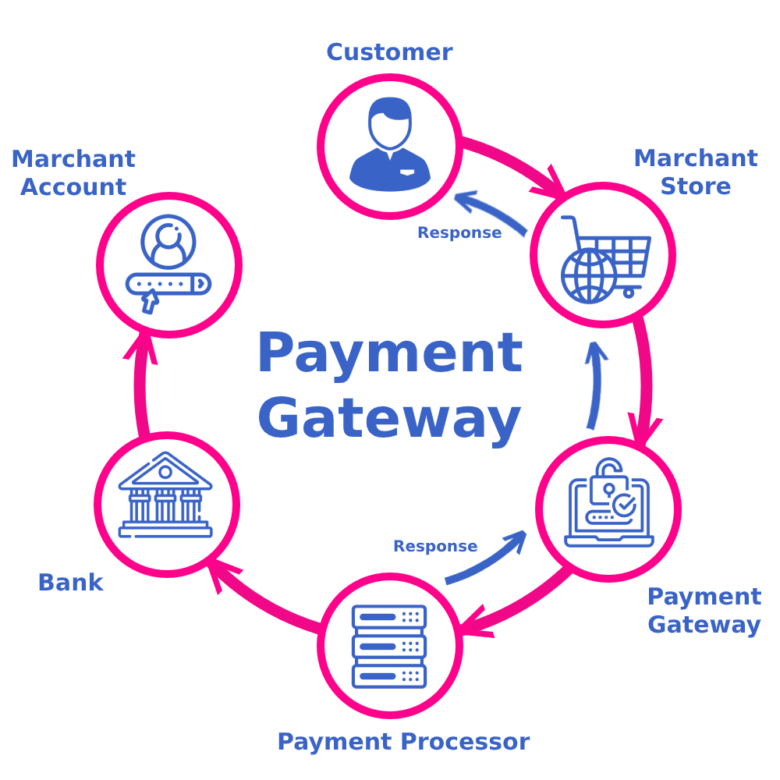
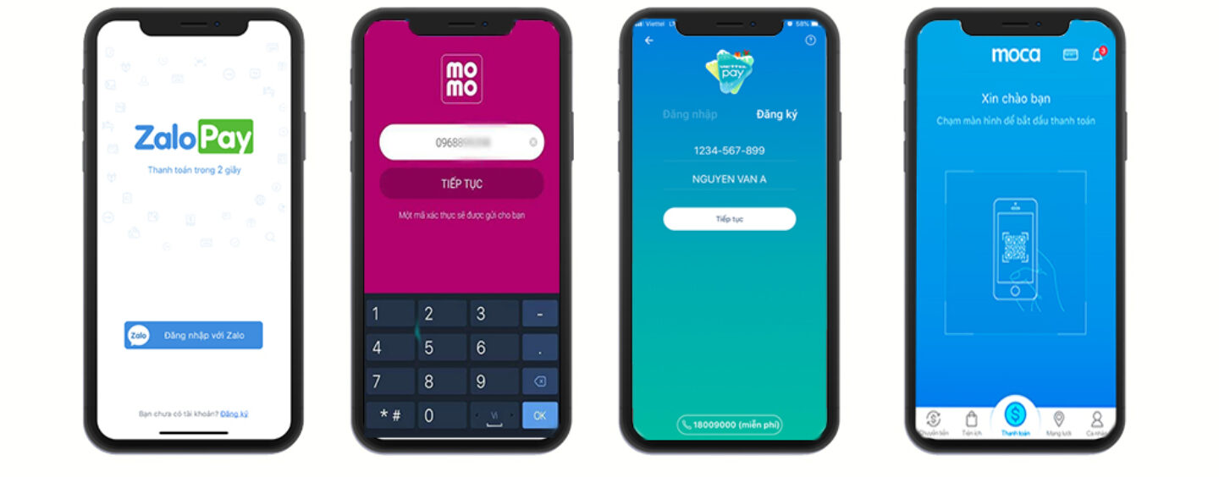
4.The most popular eCommerce payment methods
Via Mobile Banking
Payment by card
Payment through the gateway.
Via QR Code
Payment by electronic wallet

Slide 30
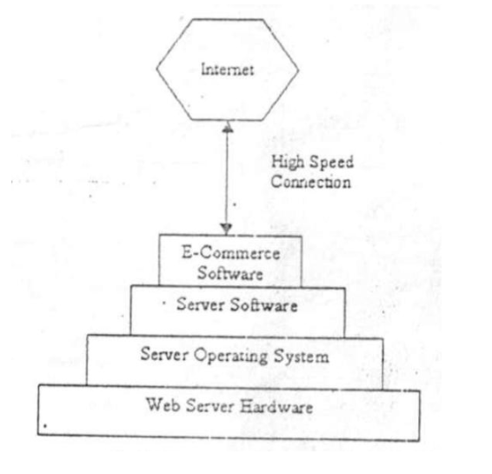
III.Hardware requirements for e-commerce

Slide 31
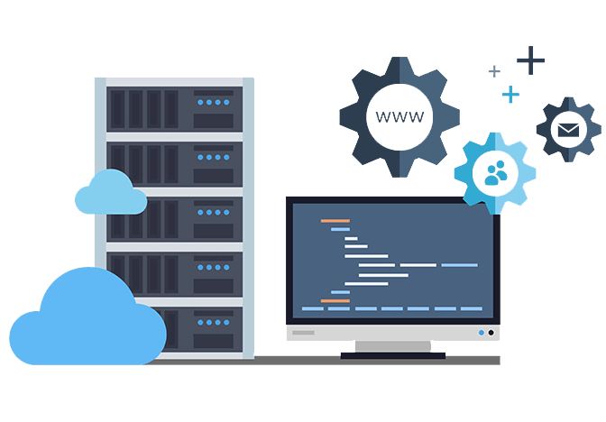
Web Servers
+Web Server Hardware
+Server Computers

Slide 32
IV.Software requirement

Slide 33
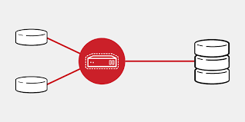




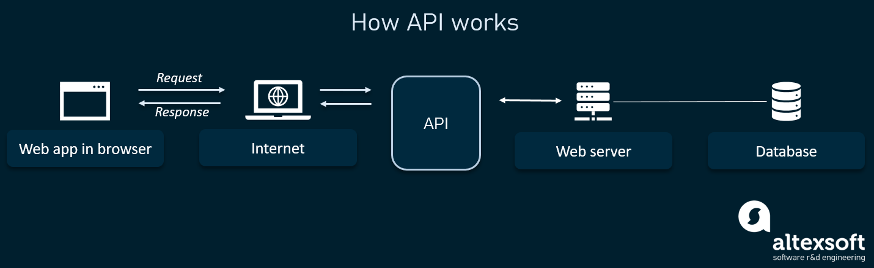
IV.Software requirement
To build an ecommerce website , we need a domain, hosting provider, integrated payment provider, platform, Initial capital to create product and packaging for product shipping.
CMS
API
Database
Middleware
Web Analytics
Text analytics
Text analytics is also known as text data mining, roughly equivalent to text analytics. Text analytics shows the drawing of meaningout of written communication. Best tools for text analytics are listed below:
-QDA miner, WordStat, SimStat.
Ecommerce analytics is like a report that shows the purchase activity and transaction details on the website. E-commerce analysis allows you to analyze average order value, conversion rate, time to purchase and other data.
Web analytics enables a business to attract more visitors, retain new customers for goods and services. Following are the best tool to analyze web traffic:
-Google analytics, Spring metrics, Woopra, Clicky, Mint, Chartbeat.
An API is the easy and seamlessly process of sharing data between different applications, In other words, API specifies how software components should interact.Top e-commerce API’s:
●Amazon API, Shopify API, ebay API, Woo commerce API, Magento.
Middleware connects disparate computer systems and allows them to send data from one side to the other. Following are the common middleware:
●Database middleware, application server middleware, message-oriented middleware, web middleware, transaction processing monitors.
E-commerce transactions are ideally suited for relational database instead of document databases. Here are the database design which is used in e-commerce website development:
-Oracle database., MS SQL, MY SQL, IBM BD2, IBM Informix.
CMS is used to create and manage digital content. The content includes enterprise and web content management system. Following CMS best for ecommerce:
● Magento, Woo commerce, Shopify, Prestashop, OpenCart.

Slide 34
V.System performance optimization

Slide 35
1) What is eCommerce optimization?
e-Commerce optimization is a holistic approach to improving your website and allowing visitors to easily convert into customers. From navigation and design to content and product descriptions, everything on your website should be intentionally leading users towards the end goal: purchasing your products or services.

Slide 36
2) Why is optimize important?
-The purpose of optimization is maximizing factors such as productivity, strength, reliability, longevity, efficiency, and utilization.

Slide 37
3) 13 Tips for eCommerce Optimization
1.Improve Product Pages:
3.Use Personalization.
5.Use an Upsel
7.Overcome Other Specific Objections
9.Build an Email List:
11.Automate Your Email Marketing
13.Troubleshoot Common Errors
JAN
FEB
MAR
APR
MAY
JUN
JUL
AUG
SEP
OCT
NOV
DEC
NEXT
2.Optimize Your Pricing.
4.Optimize for Mobile
6.Create Urgency With Flash Sales
8.Reduce Cart Abandonment
10.Split Test Your Email Optins and Campaigns:
12.Get Feedback: Get customer feedback

Slide 38
VI.System Upgradation

Slide 39
1) When To Upgrade Your E-Commerce Platform
If your current e-commerce system meets your present needs and you’re still experiencing high conversion rates, you probably won’t need to make a change immediately. However, if you notice any of the following signs, you should strongly consider upgrading or implementing a new integrated
e-commerce platform:
+Diminished ROI
+Lack of scalability
+Inadequate flexibility
+Customer dissatisfaction

Slide 40
2) What Is An Integrated Solution?

Slide 41
3) The Benefits Of An Integrated Solution In E-Commerce
Integrated e-commerce platform solutions offer a host of advantages for online business operations, including:
+Streamlined data entry:
+Fewer errors:.
+Record synchronization:
+Reduced cycle times
+Cost savings

Slide 42
4) Choosing A New Solution
-Consideration of the following factors will help you select the right integrated e-commerce solution for your business:
+Two-way integration:
+Cloud-based:
+Allow for testing
+Access to training and support

Slide 43
5) Tip to upgrade your e-commerce website:
Even if your e-commerce website receives impressive traffic and your conversion rate hovers at acceptable levels, there are still upgrades you can do. Even minor improvements can significantly impact your ability to attract clients and turn them into paying customers. With that in mind, here are eight steps you can take to upgrade your e-commerce website:
+Leverage Data
+Maximize SEO
+Improve Your Look
+Direct Traffic to Key Areas
+Include Engaging Content
+Simplify Purchase Process
+Deliver First-Rate Customer Service
+Upgrade Your Backend

Slide 44
6) Example of upgrading your website
Step 1: Revise Your Website
Step 3: Visual Attraction And High-Quality Photos
Step 5: Connecting Your Business Website With Social Networks
1
3
5
2
4
6
Step 2: Web Hosting Upgrade
Step 4: Site Must Be Mobile-Friendly
Step 6: Perform simple A/B testing

Slide 45
THANKS!
Any questions?

